Slide 1

Digital Logic and Numeral Systems

Slide 2
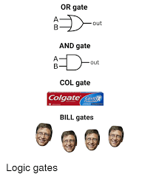
Digital Logic:
Also known as Boolean Logic, is the fundamental principle underneath all of computing.
It quite literally is the use of all the 1s and 0s from the ground up.

Slide 3
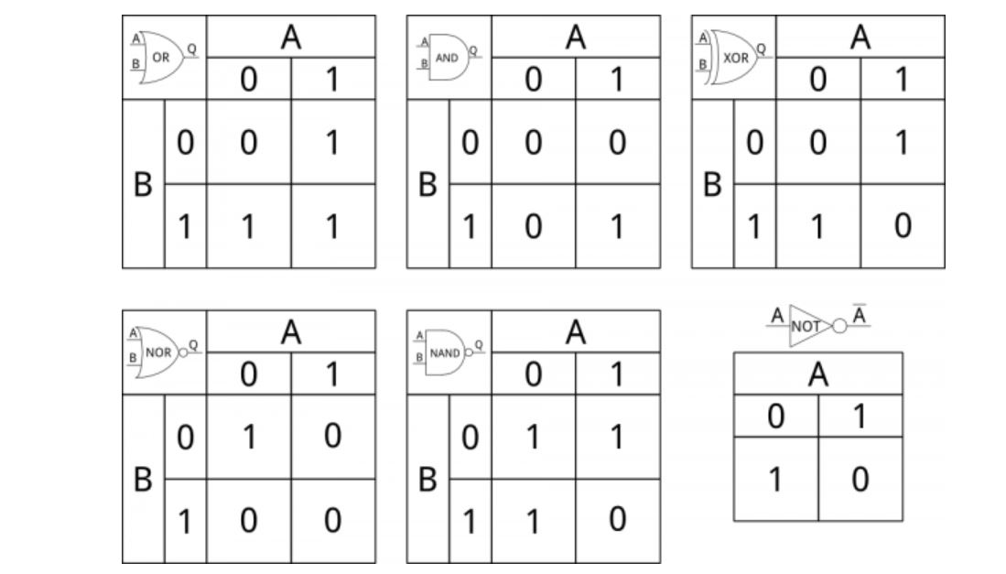
Main operations: AND, OR, NOT, XOR, NOR and NAND

Slide 4
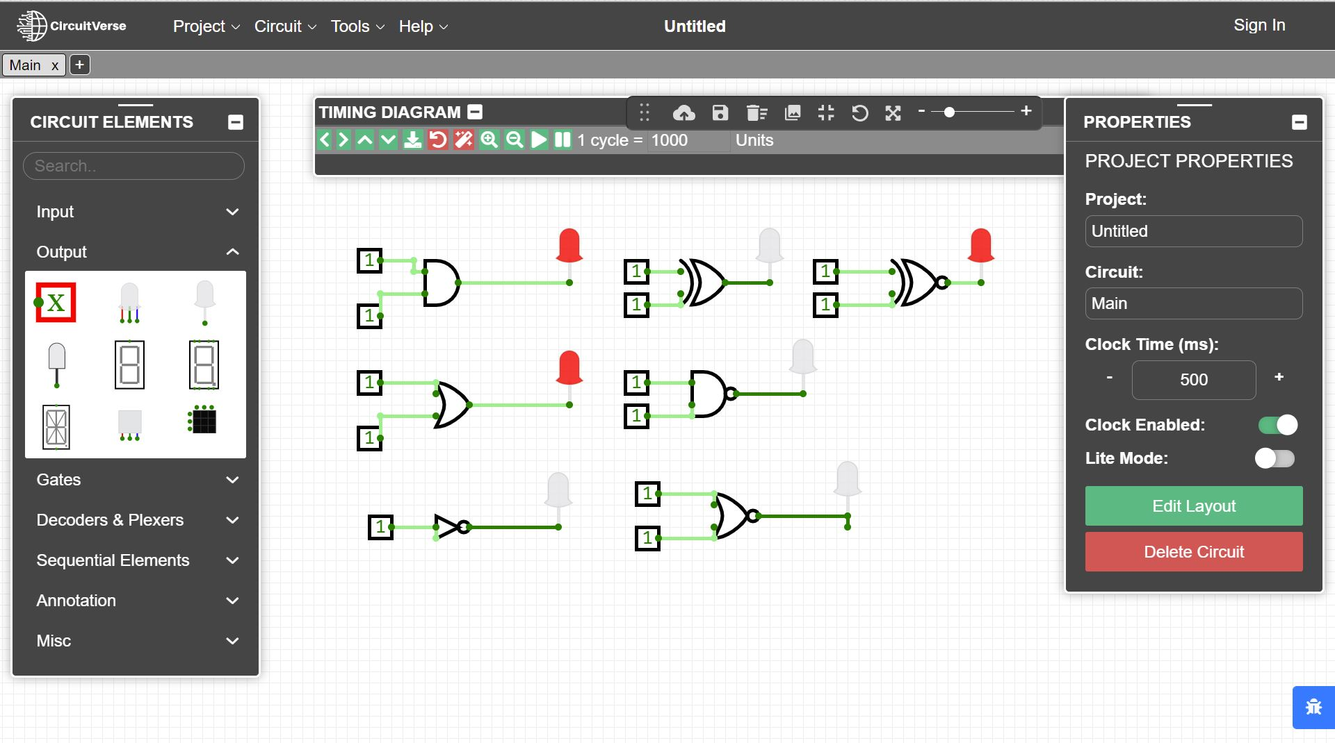
Classroom Tool: CircuitVerse

Slide 5
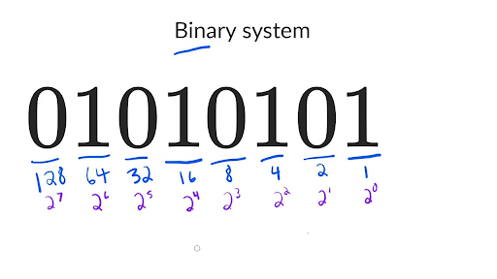
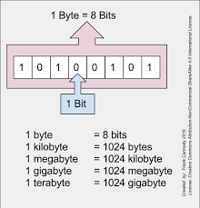
Binary

Slide 6
Binary uses:
Networking Addressing
Understanding Data types/sizes in Programming
Digital Electronics

Slide 7
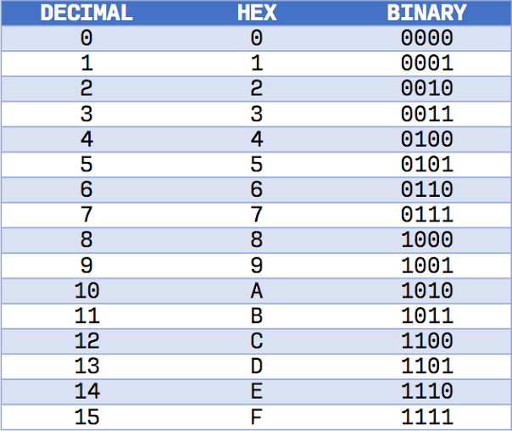
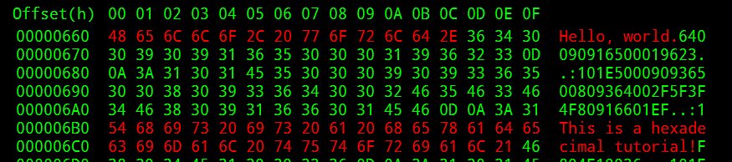

Hexadecimal:

Slide 8
Hexadecimal Uses
Color Pallette
More digestible way of viewing information

Slide 9
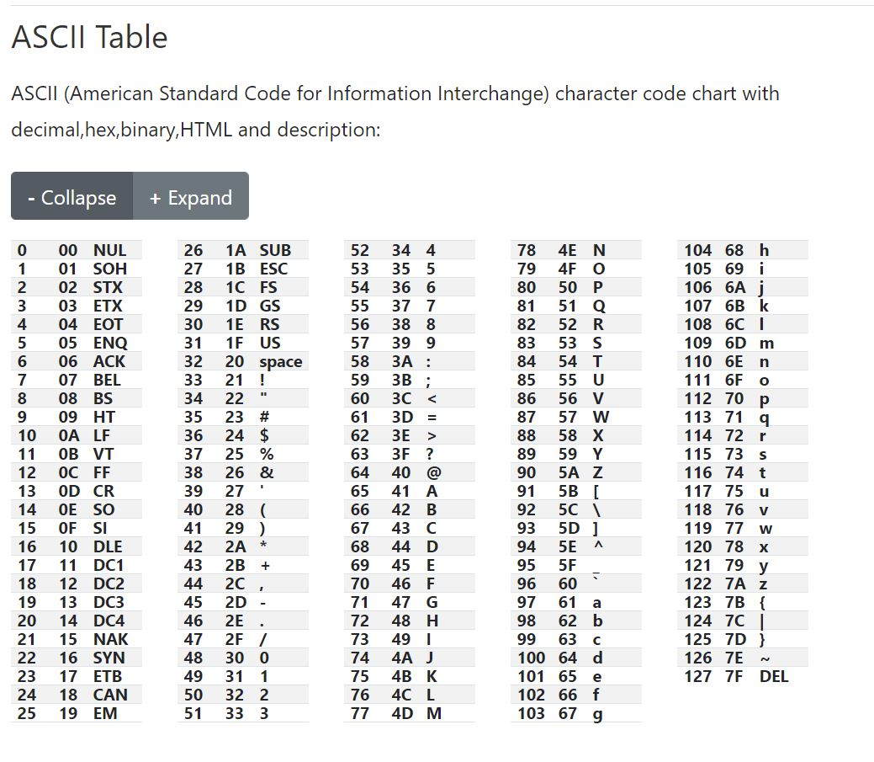
ASCII

Slide 10
Resources I use:
https://www.rapidtables.com/convert/number/hex-dec-bin-converter.html
https://www.rapidtables.com/calc/math/binary-calculator.html
https://bitwisecmd.com/ This is a good resource for Bitwise operations, Visually shows the calculation
https://learn.sparkfun.com/tutorials/digital-logic/all

